Slide 1
Getting Ready for the Final Exam Simulation

Slide 2
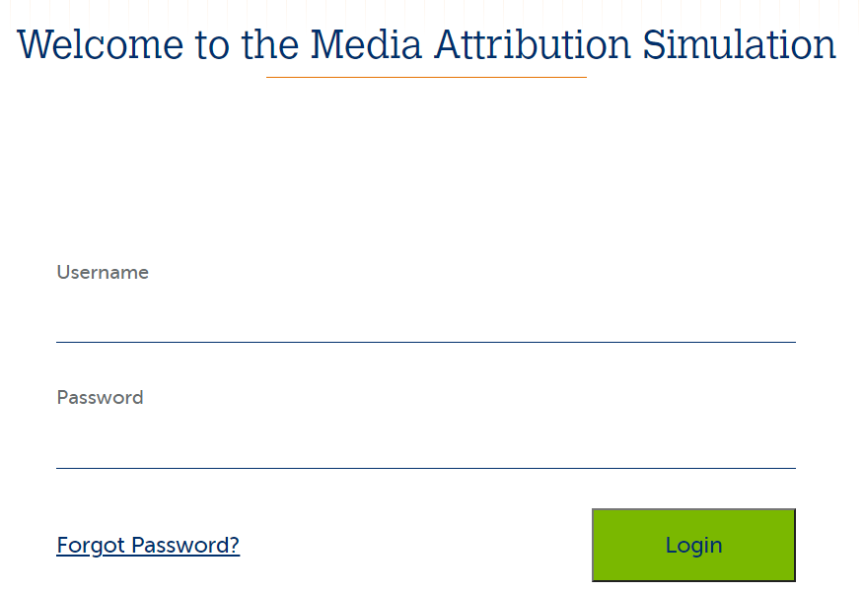
How do I access it?
Website: https://forio.com/app/darden/marketing/
Username and Password: Will be emailed to you
Timeline:
Test Runs – March 21 – March 24 & March 24 - March 26
Can ask me questions during the Test Runs
We will play one round of the simulation on March 21 during Week 10 synch session
Game Runs – March 26 – March 30
I will use the scores from the game runs for your grade

Slide 3
Video Resources for the Simulation
Overview of the simulation: http://www.kaltura.com/tiny/jamsn
Demos:
About the simulation and choice options: http://www.kaltura.com/tiny/oyf4j
Tools to analyze the results: http://www.kaltura.com/tiny/ifyk9
How to run A/B tests of the campaigns: http://www.kaltura.com/tiny/n09u2

Slide 4
Simulation Timeline (Revisited)
Trial/Testing Phase:
Tonight after you receive your login information until June 17 (noon EST)
Reset Trial/Testing Phase:
June 17 (approximately noon EST) until June 18 (appx. noon EST)
Final Exam Phase:
June 18 (appx noon EST) after you receive your login information
Need to finish your final decision (5 decisions total) by June 21 noon EST

Slide 5
Exercise minder
ExerciseMinder Devices provides wearable fitness trackers in the US.
Their flagship product is ExerciseMinder Pro, an intelligent wristwatch.
It tracks exercise efforts and physical activity
It is paired with an App
Price of the wristwatch is $30, and the app has an annual subscription of $50/year.
Subscription provides users ability to set fitness goals, receive personal recommendations for diet and exercise routines

Slide 6
Exercise minder Media Attribution
Company uses Television, Facebook, paid search and email campaigns to acquire new customers and retain existing customers.
Campaigns are used to educate customers about benefits of exercise, promote word of mouth and advertise limited time promotions
Management uses an analytics dashboard, Exercise MarTech, to track investments in different media, develop prescriptive analytics about the effect of different media and campaigns on customer acquisition and retention.
The data driven culture of ExerciseMinder promotes use of A/B testing to test hypotheses about different media allocation strategies.

Slide 7
Exercise Minder Devices challenge
ExerciseMinder Pro has more than 90% brand awareness and a market share of 80%
Management does not want to assume the high awareness and market share would continue forever
There are several startups with niche product offerings that could become the next breakout brand
You have 5 periods to accomplish the goals of the firm
The board and executive management team has set aggressive growth goals
Grow installed base by 200%
Keep marketing ROI at 3.0 or higher

Slide 8
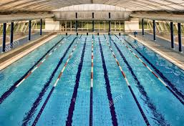
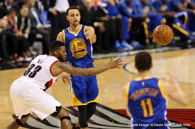
Media synergies – not swimming lanes

Slide 9
The Three Pillars
Data Science
Intuition
Experimentation

Slide 10





Different paths to purchase
Bonnie
Clyde

Slide 11
Purchase Funnel
Awareness
Interest
Desire
Action
Media Channels – TV, Facebook
Media Channels – Paid Search, Email
Top Funnel
Bottom Funnel

Slide 12
Too Many Paths to Purchase
Customer # | First Interaction | Second Interaction | Third Interaction | Product Purchase
1 | Facebook | Paid Search | Email | Yes
2 | TV | 0 | 0 | No
3 | Organic Search | 0 | 0 | No
4 | TV | Paid Search | Email | Yes
5 | Email | 0 | 0 | No
6 | Facebook | TV | 0 | Yes

Slide 13
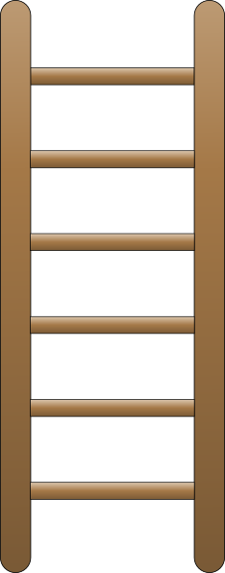
Media Attribution Ladder
Data Science + Experiments
RETURN
ON
MEDIA
SPEND
Data Science
Experiments
Rule Based System

Slide 14




Rule-based System
Attribution Rule |  | Media Weight
 |  | First | Second
 | Last Interaction | Email | TV
 | First Interaction | Facebook | TV
 | Linear | Facebook, TV, Paid Search, Email
 | Time Decay | Email, TV | Paid Search

Slide 15
Experiments - Customer Purchase Process
Without Facebook
With Facebook
# of Emails
1,000
# of Emails
1,000
Impressions
Impressions
900
800
Clicks
Clicks
200
400
Product Purchase
Product Purchase
50
150

Slide 16
Synergy between Email and Facebook
Email Metric | Without Facebook | With Facebook | Lift in Email Metrics From Display
Impression Rate | 80% | 90% | 112%
Click Through Per Impression | 25% | 44% | 176%
Click Through Conversion | 25% | 38% | 150%
Email Conversion | 5% | 15% | 300%

Slide 17
Data Science Tips
Direct Effects - Identify the drivers of customer acquisition/retention
E.g., TV, email, paid search, display, etc.
Indirect Effects - Identify the drivers of effectiveness for each of the media channels if they affect customer acquisition/retention
E.g., are TV click throughs improved with paid search impressions?
Put more resources on media channels that provide direct effect and then lower (and additional) resources on channels that have indirect effects.

Slide 18
Exercise Minder Challenge
The CFO has raised the issue of maintaining healthy margins and has asked CMO to improve efficiency of the marketing activities.
The CFO observed that email campaigns seem to be cheap and a majority of customer acquisitions seem to be a result of click through from email campaigns.
Does Exercise Minder need all the different media channels to advertise?
Is the CMO overspending in TV, Facebook and Paid Search?

Slide 19
Media Attribution-Continuous Improvement Process
Review Performance on Dashboard
Regression to Test Purchase Funnel Heuristics
Reallocate Media Weights and Campaigns
Experiment and Evaluate the Media Effectiveness
Review Purchase Funnel Heuristics

